Slide 1


ELIMINATING FIRST-ORDER INTERNAL MULTIPLES WITH DOWNWARD REFLECTION AT THE SHALLOWEST INTERFACE: Theory and initial examples
Wilberth Herrera
University of Houston
September 25, 2013

Slide 2
Outline
When do we need to eliminate (rather than attenuate)
internal multiples and why?
2. The inverse scattering series and attenuation of internal multiples.
The elimination subseries for internal multiples of first-order,
generated at the shallowest reflector.
Comments and conclusions.

Slide 3
Internal multiple interfering with a primary
A configuration in which the Energy-minimization adaptive subtraction is not useful.
Attenuation of the IM amplitude might not be enough:
Amplitude attenuation
P
IM
P + IM
P + IM’
Internal multiple destructively interfering with a primary

Slide 4
Outline
When do we need to eliminate (rather than attenuate)
internal multiples and why?
2. The inverse scattering series and attenuation of internal multiples.
The elimination subseries for internal multiples of first-order,
generated at the shallowest reflector.
Comments and conclusions.

Slide 5





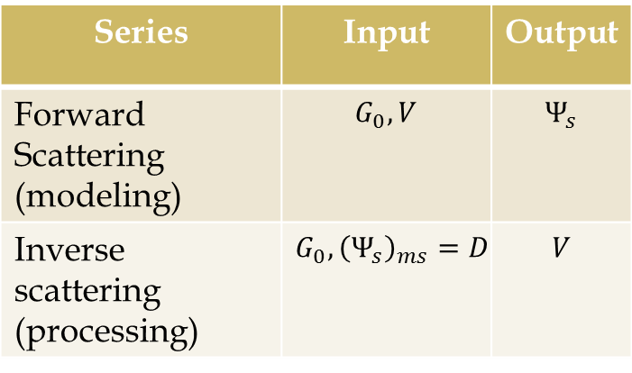
The central challenge of seismic exploration
ms
$${{(Ψ}_{s})}_{m}=D$$
$$L_{0}G_{0}=−δ(r−r_{s})$$
$${L≡L}_{0}+V$$
$$Ψ_{s}$$
Series | Input | Output
Forward Scattering (modeling) | $$G_{0}, V$$ | $$Ψ_{s}$$
Inverse scattering (processing) | $${G_{0},{\left(Ψ_{s}\right)}_{ms}=D }_{}$$ | $$V$$
$$L$$

Slide 6
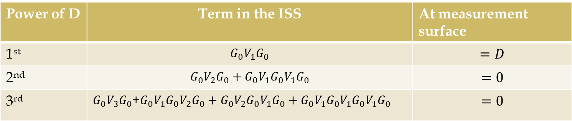





The inverse scattering series
Forward scattering series
Inverse scattering series (ISS)
$Ψ_{s}=G_{0}VG_{0}$+$G_{0}VG_{0}VG_{0}$+$G_{0}VG_{0}VG_{0}VG_{0}+⋯$
$$V=V_{1}+V_{2}+V_{3}+⋯$$
$$D$$
$$D^{2}$$
$$D^{3}$$
$${{(Ψ}_{s})}_{ms}=D={(G_{0}V_{1}G_{0})}_{ms}+{(G}_{0}V_{2}G_{0})_{ms}+{{(G}_{0}V}_{1}G_{0}V_{1}G_{0})_{ms}+⋯$$
Power of D | Term in the ISS | At measurement surface
1st | $$G_{0}V_{1}G_{0}$$ | $$=D$$
2nd | $$G_{0}V_{2}G_{0}+{G_{0}V}_{1}G_{0}V_{1}G_{0}$$ | $$=0$$
3rd | $G_{0}V_{3}G_{0}$+$G_{0}V_{1}G_{0}V_{2}G_{0}+G_{0}V_{2}G_{0}V_{1}G_{0}+G_{0}V_{1}G_{0}V_{1}G_{0}V_{1}G_{0}$ | $$=0$$

Slide 7

























Diagrammatic interpretation of terms
in the forward scattering series
$$G_{0}$$
$$G_{0}$$
$$G_{0}$$
$$G_{0}$$
$$V$$
$$G_{0}$$
$$V$$
$$G_{0}$$
$$V$$
$$G_{0}$$
$$G_{0}VG_{0}$$
$$V$$
$$G_{0}$$
$$V$$
$$G_{0}VG_{0}VG_{0}$$
$$V$$
$$G_{0}$$
$$G_{0}$$
$$G_{0}$$
$$G_{0}$$
$$G_{0}$$
$$V$$
$$V$$
$$V$$
$$G_{0}VG_{0}VG_{0}VG_{0}$$

Slide 8







Leading order attenuation
of internal multiples
$$G_{0}$$
$$V_{1}$$
$$G_{0}$$
$$G_{0}$$
D’
D
$$G_{0}$$
$$V_{1}$$
$$V_{1}$$
It is completely data-driven
Predicts the exact time and an approximate amplitude for all internal multiples of first-order, including internal multiples with converted waves (Weglein and Coates).
$$G_{0}V_{1}G_{0}V_{1}G_{0}V_{1}G_{0}$$
Leading order
attenuator of 1st order IM
Araujo and Weglein (1994)

Slide 9

















An analytic example: spike-waves
At normal incidence
$$D\left(t\right)=R_{1}δ\left(t−t_{1}\right)+ T_{01}R_{2}T_{10}δ\left(t−t_{2}\right)+T_{01}T_{12}R_{3}T_{21}T_{10}δ\left(t−t_{3}\right)+IM$$
$$R_{2}^{′}$$
$$R_{3}^{′}$$
R_{i}: Reflection coefficient at the i-th
reflector for an upward reflection.
T_{ij}: Transmission coefficient for a wave going from media ${(c}_{i}, { ρ}_{i})$ to media ${(c}_{j}, { ρ}_{j})$.
t_{i}: Traveltime of the primary associated with the i-th reflector.
$$c_{0}, { ρ}_{0}$$
$$T_{01}$$
$$R_{1}$$
$$Z_{1}$$
Top salt
$$T_{10}$$
$$R_{2}$$
$$c_{1},{ ρ}_{1}$$
$$T_{12}$$
$$Z_{2}$$
Base salt
$$T_{21}$$
$$c_{2},{ ρ}_{2}$$
$$R_{3}$$
$$Z_{3}$$
Target
$$c_{3},{ ρ}_{3}$$

Slide 10




The leading-order attenuator
for 1D and normal incidence
$$\int_{−∞}^{∞}{dze^{ikz}b_{1}(z)}\int_{−∞}^{z−ε}{dz′e^{−ikz^{′}}b_{1}(z^{′})\int_{z^{′}+ε}^{∞}{dz′′}e^{ikz^{′′}}b_{1}(z^{′′})}$$
Temporal Fourier transform
$$D\left(ω\right)=R_{1}e^{iωt_{1}}+{R′}_{2}^{}e^{iωt_{2}}+R_{3}^{′}e^{iωt_{3}}+⋯$$
$$k=2\frac{ω}{c_{0}}$$
$$z_{i}=\frac{c_{0}t_{i}}{2}$$
$$b_{1}\left(k\right)=R_{1}e^{ikz_{1}}+{R′}_{2}^{}e^{ikz_{2}}+R_{3}^{′}e^{ikz_{3}}+⋯$$
Fourier transform on $k$
$$b_{1}\left(z\right)=R_{1}δ(z−z_{1})+{R′}_{2}^{}δ(z−z_{2})+R_{3}^{′}δ(z−z_{3})+⋯$$
Keeping only primaries
$$b_{1}\left(z\right)=R_{1}δ(z−z_{1})+{R′}_{2}^{}δ(z−z_{2})+R_{3}^{′}δ(z−z_{3})$$

Slide 11














Example of an internal multiple of 1st order, with
Downward reflection at the shallowest interface
$$T_{01}$$
$${−R}_{1}$$
$$c_{0}, { ρ}_{0}$$
$$Z_{1}$$
$$T_{10}$$
$$T_{12}$$
$$c_{1},{ ρ}_{1}$$
$$Z_{2}$$
$$R_{2}$$
$$T_{21}$$
$$c_{2},{ ρ}_{2}$$
$$Z_{3}$$
$$R_{3}$$
$$c_{3},{ ρ}_{3}$$
$${IM}_{213}={−R}_{1}T_{01}R_{2}T_{12}R_{3}T_{21}T_{10}δ\left(t−(t_{2}+t_{3}−t_{1})\right)$$

Slide 12




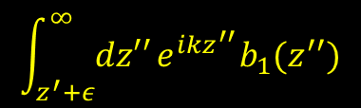





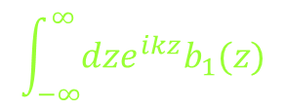
Prediction of the leading-order attenuator for ${IM}_{213}$
$$c_{0}, { ρ}_{0}$$
$$z_{1}$$
$$c_{1},{ ρ}_{1}$$
$$z_{2}$$
$$c_{2},{ ρ}_{2}$$
$$z_{3}$$
$$c_{3},{ ρ}_{3}$$
$$\int_{−∞}^{∞}{dze^{ikz}b_{1}(z)}$$
$$\int_{−∞}^{z−ε}{dz′e^{−ikz^{′}}b_{1}(z^{′})}$$
$$\int_{z^{′}+ε}^{∞}{dz′′}e^{ikz^{′′}}b_{1}(z^{′′})$$
$${=R}_{1}{R′}_{2}^{}{R′}_{3}^{}e^{ik(z_{2}+z_{3}−z_{1})}$$
$${R′}_{2}^{}δ\left(z−z_{2}\right)$$
$$R_{1}δ(z−z_{1})$$
$${R′}_{3}^{}δ\left(z−z_{3}\right)$$
$$R_{1}T_{01}R_{2}T_{10}T_{01}T_{12}R_{3}T_{21}T_{10}δ\left(t−(t_{2}+t_{3}−t_{1})\right)$$
$$={−T}_{10}T_{01}{IM}_{213}$$

Slide 13


Effect of the leading-order attenuator on the data
$$data+attenuator=primaries+{\left(IM\right)}_{sh}−T_{01}T_{10}{\left(IM\right)}_{sh}+⋯$$
$$\left[1−T_{01}T_{10}\right]{\left(IM\right)}_{sh}$$
Attenuation Factor
1st order internal multiples with their single downward
reflection at the shallowest interface.
$${\left(IM\right)}_{sh}≡$$

Slide 14
Outline
When do we need to eliminate (rather than attenuate)
internal multiples and why?
2. The inverse scattering series and attenuation of internal multiples.
The elimination subseries for internal multiples of first-order,
generated at the shallowest reflector
Comments and conclusions.

Slide 15
Previous work on removal of internal multiples
Early ideas to move from attenuation towards elimination of 1st order IM were discussed in Ramírez and Weglein (2007).
Internal multiple of
1st order

Slide 16
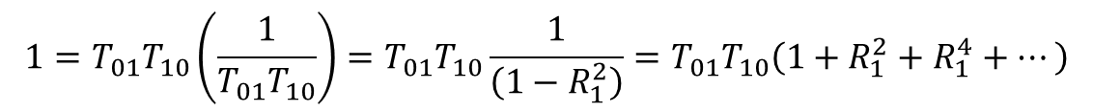


Amplitude analysis for the elimination
After the action of the leading-order attenuator, the amplitude of ${(IM)}_{sh}$ is
$[1−T_{01}T_{10}]{\left(IM\right)}_{sh}$
Is it possible to take this attenuation to total elimination?
$$1=T_{01}T_{10}\left(\frac{1}{T_{01}T_{10}}\right)=T_{01}T_{10}\frac{1}{\left(1−R_{1}^{2}\right)}=T_{01}T_{10}\left(1+R_{1}^{2}+R_{1}^{4}+⋯\right)$$
$$=T_{01}T_{10}+T_{01}T_{10}R_{1}^{2}+⋯$$

Slide 17









Localization within the ISS of the attenuation
$T_{01}T_{10}R_{1}^{2}$
$$R_{1}$$
$${(R_{1})}^{3}$$
$$R_{2}^{′}$$
$$R_{2}^{′}$$
$$R_{3}^{′}$$
$$R_{3}^{′}$$
$$T_{01}T_{10}$$
$$T_{01}T_{10}R_{1}^{2}$$
Leading-order
attenuator
The key point is to
isolate interactions

Slide 18


The second term in the elimination subseries of
${(IM)}_{sh}$
$${\begin{aligned}\int_{−∞}^{+∞}{dz e^{ikz}b_{1}(z)}\int_{−∞}^{z−ε}{dz^{′}e^{−ikz^{′}}×} \\ ℱ^{−1}\left(\int_{−∞}^{+∞}{dz^{′}e^{−ikz^{′}}b_{1}}\left(z′\right)\int_{z^{′}−ε^{}}^{z^{′}+ε^{}}{{dz}_{1}e^{ikz_{1}}b_{1}(z_{1})\int_{z_{1}−ε^{}}^{z_{1}+ε^{}}{{dz}_{2}e^{−ikz_{2}}b_{1}}(z_{2})}\right)\end{aligned}}_{}$$
$$×\int_{z^{′}+ε}^{+∞}{dz′′e^{ikz^{′′}}b_{1}(z^{′′})}$$
$b_{1}\left(z\right):$ data (containing only primaries) migrated at water speed

Slide 19
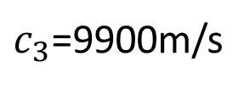
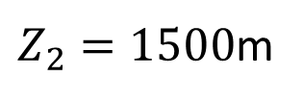
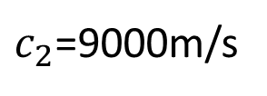
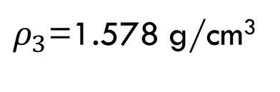
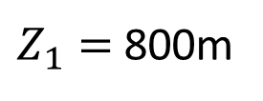
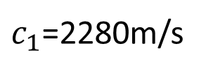
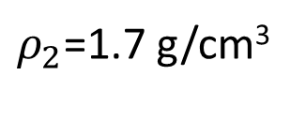
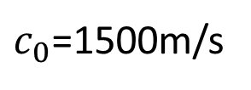
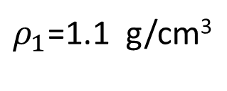
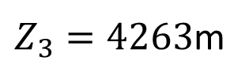

A particular three-interface model
$c_{0}$=1500m/s
$ρ_{0}$=1 g/cm³
$Z_{1}=$ 800m
$c_{1}$=2280m/s
$ρ_{1}$=1.1 g/cm³
$Z_{2}=1500$m
$c_{2}$=9000m/s
$ρ_{2}$=1.7 g/cm³
$Z_{3}=4263$m
$c_{3}$=9900m/s
$ρ_{3}$=1.578 g/cm³

Slide 20
Primaries of the model
P₁
P₂
Zoom of P₃
P₃

Slide 21

DATA
P₁
P₂
P₃ + IM₂₁₂
IM₂₁₂ : Internal multiple of first order, with downward
reflection at the reflector with depth $Z_{1}, and both$upward reflections at the reflector with depth $Z_{2}$.

Slide 22
Effect of the leading-order attenuator
Data (after attenuation of IM)
P₁
P₂
Zoom
Zoom of P₃ + IM₂₁₂
+LOA

Slide 23

Data (after the first two contributions
to the elimination of ${(IM)}_{sh}$)
P₁
P₂
P₃ + IM₂₁₂
Zoom of P₃ + IM₂₁₂
+LOA+LOE
+LOA+LOE

Slide 24
P₃
P₃+ IM₂₁₂
+ LOA+LOE

Slide 25
Workflow
Calculate the 2nd term of the elimination subseries
How to decide if there is
a need for this method?
Add the result to the prediction of the leading order attenuator, and subtract the result from the data
Data
Prediction
Apply the next term of the elimination subseries, and subtract the result from the data resulting from previous step
Change in amplitude?
Yes
No
End

Slide 26
Outline
When do we need to eliminate (rather than attenuate)
internal multiples and why?
2. The inverse scattering series and attenuation of internal multiples.
The elimination subseries for internal multiples of first-order,
generated at the shallowest reflector.
Comments and conclusions.

Slide 27
Conclusions
We have presented an algorithm which has the potential of achieving the surgical removal, without any subsurface information, of internal multiples of 1st order with downward reflection at the shallowest interface.
This is the beginning of an activity that can provide added value in complex geological configurations, where the attenuation of internal multiples is not enough, and current methods such as energy-minimization adaptive subtraction fail.

Slide 28
Additional comments
Ideas related to this work have been applied to develop another algorithm which has the potential of elimination of all internal multiples of first-order (next talk in this E-poster session).
Future work…
To derive the non-zero offset and multidimensional version of the
ideas presented in this work.
To test the resulting algorithm with non-zero offset synthetic and
field data.

Slide 29


